Slide 1
2/20 Class 6 – Model Measures of Goodness
Measures of model goodness
How to avoid overfitting
How to encode categorical fields into numeric variables
Variables for Project 2
Homework 5: create the candidate variables for Project 2

Slide 2
Comments About Project 2
The formats were all generally good
Each section should have a new page
Maybe get a native English speaker to edit text
Remember, these are anomalous records, not necessarily fraud.
Please use the term fields for the data columns and variables after we have transformed into the model inputs
The goal isn’t to find the top 10 but to rank order all records by unusualness

Slide 3
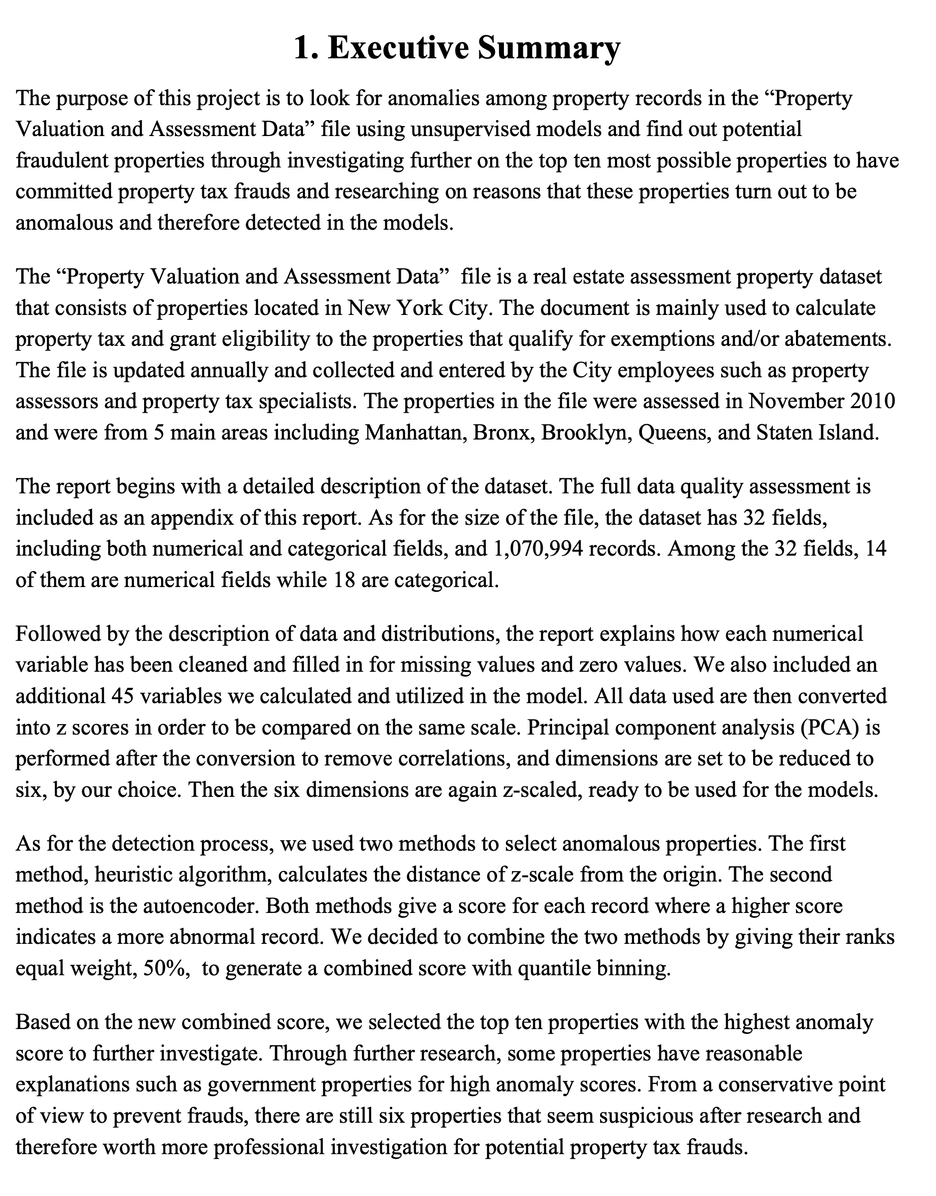
Example of a Good Executive Summary

Slide 4
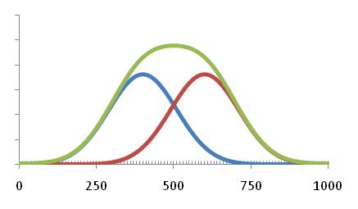
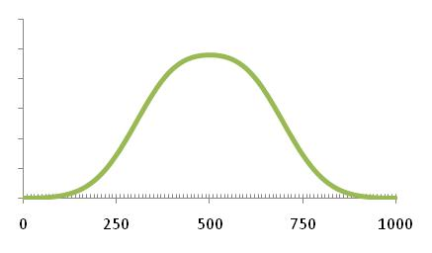
General Model Measures of Goodness
actual
predicted
Continuous target ($ loss, profit…). Use sum of error, MSE or R²
Each record has an error. Just add up the errors, or the square of the errors
Marketing models typically use lift
Lift of 3 means response is 3 times random
Binary target (good/bad). Use KS, ROC, FDR
KS is a robust measure of how well two distributions are separated (goods vs bads)
average
Cumulative Lift over random
random
Response score bin
# in that bin
goods
bads
Score bin

Slide 5
Most Common Measures of Goodness for Fraud Models
Fraud models use FDR and False positives (we use KS as a guide)
KS (Kolmogorov-Smirnov) is a robust measure of how well two distributions are separated (goods vs bads)
FDR: Fraud Detection Rate – what % of all the frauds are caught at a particular examination cutoff location. Example: FDR 50% at 5% means the model catches 50% of all the frauds in 5% of the population.
False positives: How many goods (mistakes) do I catch for each bad caught, or for all I examine.
False positive ratio = # goods caught / # bads caught
False positive rate = # goods caught / # examined
= # goods caught / (# goods and # bads caught)

Slide 6
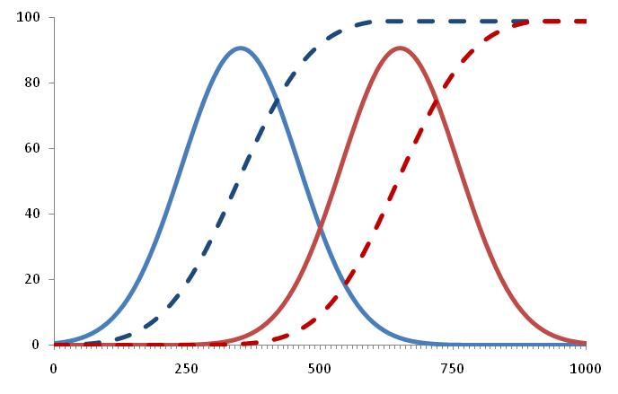
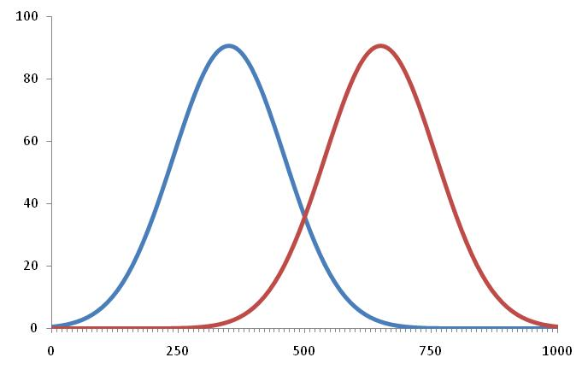
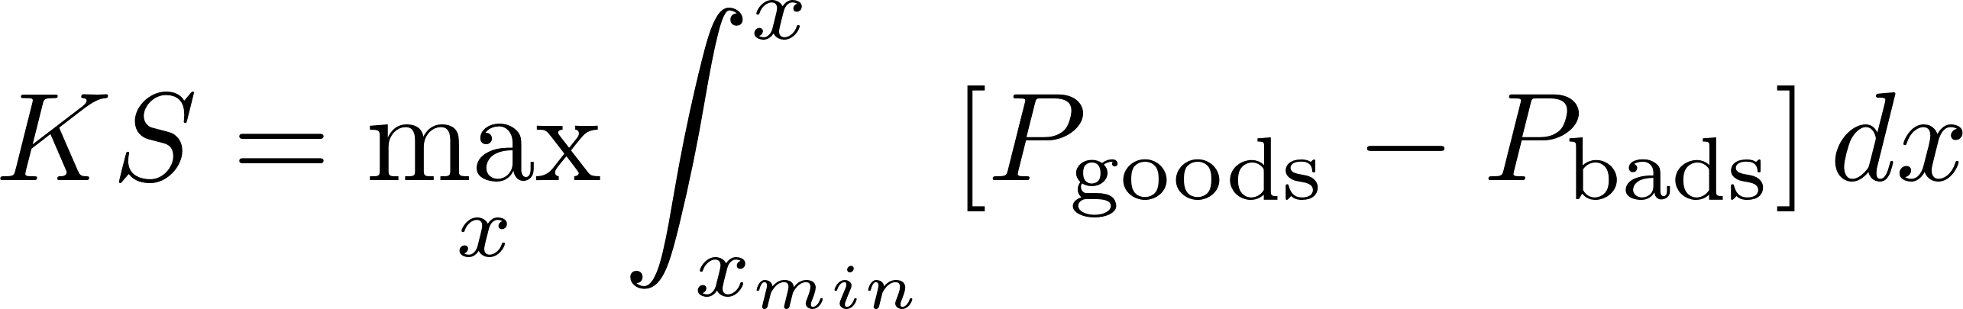
KS is a Good Guide for a Fraud Model… But is not the most important measure
We want to measure how well the goods and bads are separated
Plot the goods and bads. Start adding them up (cumulative distribution)
Doesn’t matter which side you start with
The KS is the maximum of the difference of the cumulatives
cum. goods
cum. bads
goods
bads
KS = 74

Slide 7
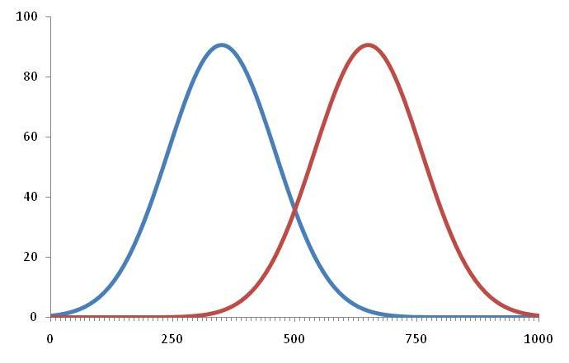
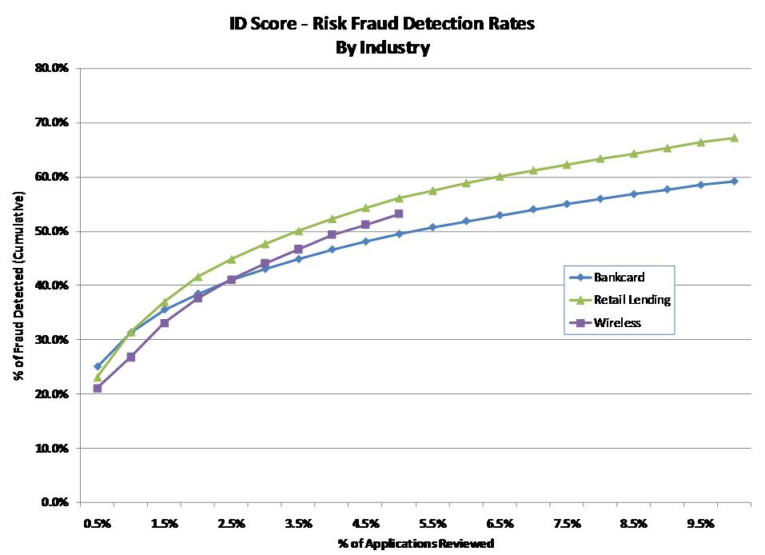
FDR: Main Measure of Goodness for Fraud
Examine from this end
Fraud Detection Rate:
% all the fraud found at a score cutoff
Goods
Bads
Fraud score
Can detect ~45% of fraud by examining 3% population
The Fraud Detection Rate (FDR) is very common in business applications. It’s more robust and meaningful than the False Positive measure of goodness.
3% population examined

Slide 8
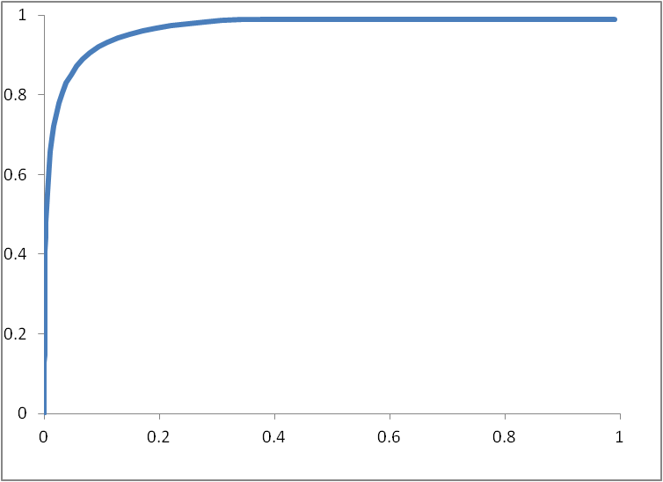
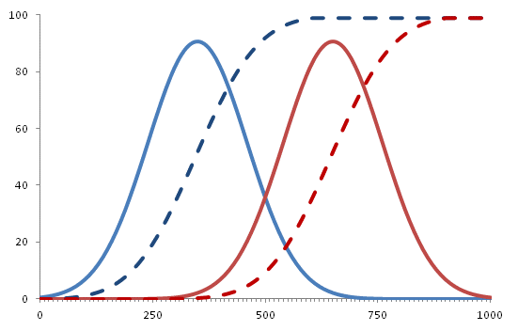
ROC/AUC: Other Goodness Measures for Binary Classification
ROC – Receiver Operating Characteristic
ROC is the plot of cum. goods by cum. bads
AUC – Area Under (ROC) Curve
ROC is this curve
KS = 74
cum. goods
Cumulative goods
AUC is this area
This line is for a random model
goods
cum. bads
bads
Cumulative bads

Slide 9
Other Measures of Goodness for Binary Classification Scores
Build a model, select a cutpoint/cutoff
The records correctly classified are true positives/negatives
The records incorrectly classified are false positives/negatives
Fraud Detection Rate (FDR) is percent of total frauds caught at a particular cutoff
False Positive Ratio = #FP / #TP
goods
bads
We want high trues, low falses
So another measure of goodness is the relationship of the trues to the falses
Using these measures require you to set a cutoff
Populations
True Negatives
True Positives
Score cutoff
Score
False Negatives
False Positives

Slide 10
Other Measures of Goodness for Binary Classification
Predicted
All these require a choice of a score cutoff
Build the confusion matrix
Accuracy = (#TP + #TN) / total #
Misclassification = (FP + FN) / total
False positive rate = FP / (FP + TN)
False positive ratio = FP / TP
True positive rate (aka Sensitivity or Recall) = TP / (TP + FN)
True negative rate (aka Specificity) = TN / (TN + FP)
Precision = TP / (TP + FP)
Type 1 error
Actual
Type 2 error
Confusion matrix
10

Slide 11
FDR: Measure of Goodness for Project 2
1) Score all records
2) Sort records by score
3) Examine subpopulations
1 x₁ x₂ x₃ … x_{n} y score
4738 x₁ x₂ x₃ … x_{n} y score
2 x₁ x₂ x₃ … x_{n} y score
67263 x₁ x₂ x₃ … x_{n} y score
high
1%
3 x₁ x₂ x₃ … x_{n} y score
2788 x₁ x₂ x₃ … x_{n} y score
4 x₁ x₂ x₃ … x_{n} y score
983 x₁ x₂ x₃ … x_{n} y score
2%
5 x₁ x₂ x₃ … x_{n} y score
27364 x₁ x₂ x₃ … x_{n} y score
…
6 x₁ x₂ x₃ … x_{n} y score
5849 x₁ x₂ x₃ … x_{n} y score
3%
7 x₁ x₂ x₃ … x_{n} y score
73 x₁ x₂ x₃ … x_{n} y score
4%
8 x₁ x₂ x₃ … x_{n} y score
43985 x₁ x₂ x₃ … x_{n} y score
9 x₁ x₂ x₃ … x_{n} y score
19375 x₁ x₂ x₃ … x_{n} y score
low
…
…
4) For each subpopulation:
5) Build Fraud Detection Rate plot
FDR
A) # Frauds caught (sum the y’s)
B) % Frauds caught = # frauds caught / total # frauds in that data set (training, testing, OOT)
20%
% Frauds caught
15%
10%
FDR @ 3% is 17.4
5%
1%
2%
3%
4%
5%
% Total Population

Slide 12
The Dark Side of Modeling: Overfitting
What if you want to fit a model to this 1-d data:
But when new data comes in that your model hasn’t seen before this fit can be very bad
y
y
x
x
With a sufficiently complex model you can always get a perfect fit
A simpler model likely fits new data better
y
y
x
x
Overly-complex models don’t generalize well – Overfitting
Must balance model complexity with generalization

Slide 13
How to Avoid Overfitting: Training/Testing Data
Divide data into two separate sets: one for training and one for testing
Build the model on the training data, then evaluate it on the testing data
Measure of model fitness
For example, model error
Model error for the
testing data
This represents the REAL model performance
Model error for the
training data
Stop here
Model complexity
( # free parameters, # training iterations…)

Slide 14
Creating Special Expert Variables
An important part of modeling is the creation of special variables: nontrivial/nonlinear combinations of data that likely relate to the target
Examples are
Ratios (balance/limit, payment/balance,…)
Velocities (# events in various time windows)
Max/mins (max(#connections,10)…)
Logarithms (log(income), log(max(purchase))…)
Much of the art of modeling is in creating special variables. Requires
Good domain knowledge (dynamics of process, human behavior)
Clear understanding of the business objective/target/use
Understanding of the strengths/weaknesses of the modeling techniques
Deep understanding of the data: sources, cleanliness, idiosyncrasies, limitations…

Slide 15
Must Go Back in Time to Build Data Records
Slide the Observation Point Across Time; Build as many records as possible
Makes models more robust, stable, invariant to seasonality
Use this
To predict this
Model inputs x
Model output y
Time
“Past”
“Future”
Really
today
Pretend
you’re
here
(observation point)
Move the observation point
Use this
To predict this
This:
Model inputs x
Model output y
is a data record for building the model
Scoring
time
The records look like this: (x₁,x₂,x₃,…,x_{n},y)
(x₁,x₂,x₃,…,x_{n},y)
(x1,x₂,x₃,…,x_{n},y)
Make hundreds of thousands of records for model building
inputs
output
…

Slide 16
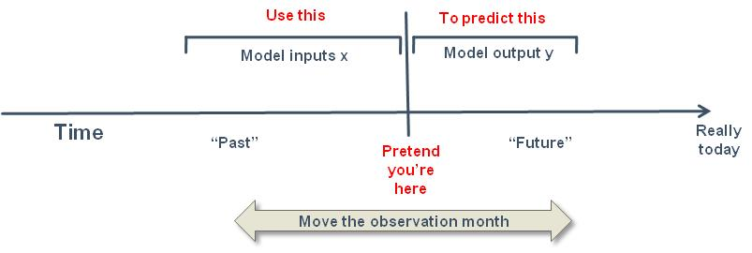
How to Assemble Modeling Data: Inclusions & Exclusions
Pretend you’re sitting at a time in the past
Look at that record’s “past” to collect potential model inputs
Look at that record’s “future” to decide model output (good, bad, loss…)
Slide the observation point across time to get lots of different modeling records that cover lots of time
Exclusions: remove any records that will inappropriately affect the model:
Remove people/records whom the model won’t be used on (employees, VIPs…)
Remove records with the outcome you’re trying to predict (bad, loss, cancel…) at the observation time. Examples to avoid:
Predict future delinquency but record is already delinquent
Predict future inactivity but account has already gone inactive
Predict collectability but phone number has been overwritten with collection agency

Slide 17
Out of Time Validation Helps Assure Model Robustness
Use this time period for
model training and testing
Use this time period for
Out Of Time validation
Training, Testing
OOT Validation
Really
today
Time
Validation that the model works even in time frames it has never seen
Provides increased confidence that the model will perform when implemented
We will use the last 2 months (November, December) records as OOT data
Build all variable across all time, then separate the OOT records

Slide 18
Function to Smoothly Transition Between Values
Frequently we want a value to smoothly transition from one measurement to another
Very common when we’re not sure if we have enough samples in a group
Calculate a measure at some (small) group level
Calculate it also at a higher-hierarchical group level (could be entire population)
Smoothly transition from the granular level if enough statistics to the higher group level if not enough statistics
Example:
R_{city}
Actual fraud rate in a city: R_{city} =3
<R_{city} >
2c
Actual fraud rate in that state: R_{state} =1
Value we want
Here I used c=4, n_{mid}=15
R_{state}
Value we want: typical fraud rate for that city: <R_{city} >
n_{mid}
Number of samples n
Can use this smoothing formula:

Slide 19
How to Encode Categorical Fields
Let’s say you have a field that can take values A, B, C…
How do you encode these categories A, B, C… into numbers to go into a modeling algorithm?
Label encoding: [A, B, C] -> [1, 2, 3]. Really bad. ML algorithm assumes these are numeric
Dummy, one hot: Expand the category list into new variables:
[A, B, C] -> x1, x2, x3… with binary values. So a record with value “B” -> 0,1,0,0…
Problem: explodes dimensionality, which is the opposite of what we want in modeling
Other dimensionality expanding: contrast, Helmert, GLM, comparison…
Don’t do these
For unsupervised models, categorical fields are mostly used for linking, grouping and profiles
When you have a label (supervised) can use Target Encoding/Risk Tables: For each possible category assign a value
No dimensionality expansion; each categorical field becomes one numeric variable
Several choices to use for the value:
Average of the dependent variables for all records in that category
Log odds: log(#bad/#good), also called weight-of-evidence
Good – direct encoding to what you’re trying to predict
Bad - loss of interaction information
Must be careful about overfitting. Smoothing helps.
Do this

Slide 20
How to Do Target Encoding for Categoricals
Consider a categorical field, say f₆, that has possible values A, B, C, D
Could use a dummy variables: f₆ is transformed into 4 variables x₁, x₂, x_{3,} x₄ such that
This is bad practice for machine learning/nonlinear modeling
Better to use target encoding: build a table with values for each category
Calculate v_{A} = <y>|_{f6=A}, v_{B} = <y>|_{f6=B}, v_{C} = <y>|_{f6=C}, v_{D} = <y>|_{f6=D}
Then encode f₆ as
x₁ x₂ x₃ x₄
1 0 0 0
when f₆=A
x_{new} =
0 1 0 0
when f₆=B
f₆ ->
when f₆=C
0 0 1 0
0 0 0 1
when f₆=D
v_{A} when f₆=A
v_{B} when f₆=B
f₆ ->
x_{new} =
v_{C} when f₆=C
v_{D} when f₆=D

Slide 21
How to Avoid Overfitting When Using Target Encoding
When calculating the table values v_{A} = <y>|_{f6=A}, only use the training data. Never use the validation data.
Make sure you have a statistically sufficient sample in each category, for example, at least several dozen records.
If not enough records in a category, use expert knowledge/judgement to group categories (e.g., combine B and C together into a single category)
Should use a smoothing formula:
If still overfitting (Obj_{training} much better than Obj_{testing}), systematically remove any of these table variables and observe the result. This will identify any table variable that is overfitting.
R_{city}
<R_{city} >
2c
Value we want
Here I used c=4, n_{mid}=15
R_{state}
n_{mid}
Number of samples n

Slide 22
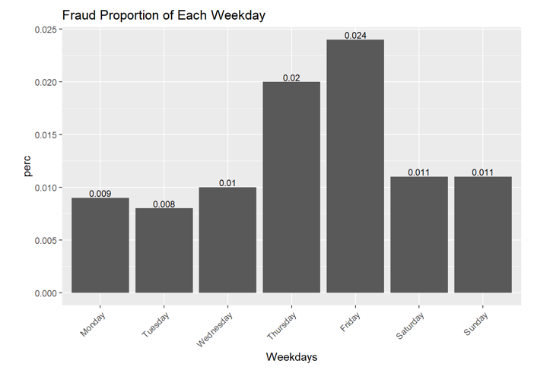
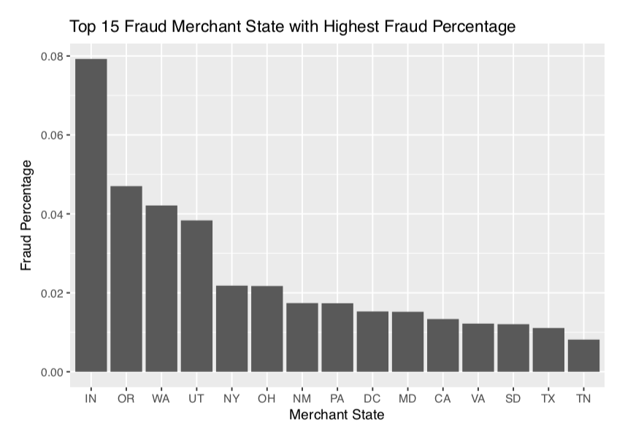
Example Risk Table/Target Encoding Variables
Some Python code that makes risk table variables:

Slide 23
Break

Slide 24
Kinds of Identity Fraud in Project 2 Data
An individual fraudster has gotten a list of identity information (stolen, bought on internet…) and is going through this list applying for many products with many identities. He uses the victims’ core identity information (SSN, name, DOB) and his own contact information (address, phone number).
A victim’s identity was compromised in a data breach and his core identity information is being used by many fraudsters.
What variables would you make for these?

Slide 25
Variables for Project 2
Create two new fields: namedob = firstname_lastname_dob
fulladdress = address_zip
Entitities for linking: ssn, fulladdress, namedob, phone
Combination groups: (ssn,fulladdress), (ssn,namedob), (ssn, phone), (fulladdress,namedob), (fulladdress,phone), (namedob,phone), (firstname,ssn), (lastname,ssn)…
For each entity and combination group:
Days since last seen: how many days since I last saw that entity or combination group
Velocity: # records seen over the past n days, n = 0, 1, 3, 7, … whatever you like. How many times have I seen that entity or combination group over the past n days.
Risk table variable for day of week
Anything else you can think of

Slide 26
Example Variables for Project 2
ssn
fulladdress
namedob
phone
ssn,fulladdress
ssn,namedob
ssn,phone
fulladdress,namedob
…
Velocity:
# records with the same over the last 0, 1, 3, 7, 14, 30 days
ssn
fulladdress
namedob
phone
ssn,fulladdress
ssn,namedob
ssn,phone
fulladdress,namedob
…
Days since:
# days since I last saw that
ssn
fulladdress
namedob
phone
ssn,fulladdress
ssn,namedob
ssn,phone
fulladdress,namedob
…
Relative velocity:
# apps with that group seen in the recent past
# apps with that same group seen in the past 1, 3, 7, 14, 30 days

Slide 27
Homework 5 – Calculate All Variables
Build all the candidate variables for Project 2
Include one risk table variable: likelihood of fraud for that day of the week. Don’t use the OOT data to calculate the risk table.
Provide basic statistics for all candidate variables:
Min, max, mean, stdev
Submit a table/excel file with all candidate variables and statistics
Probably have about 200 or so candidate variables

Slide 28
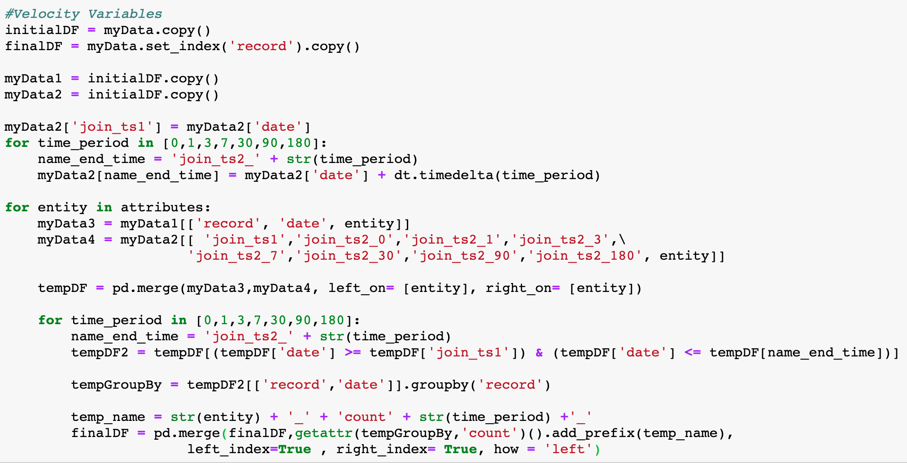
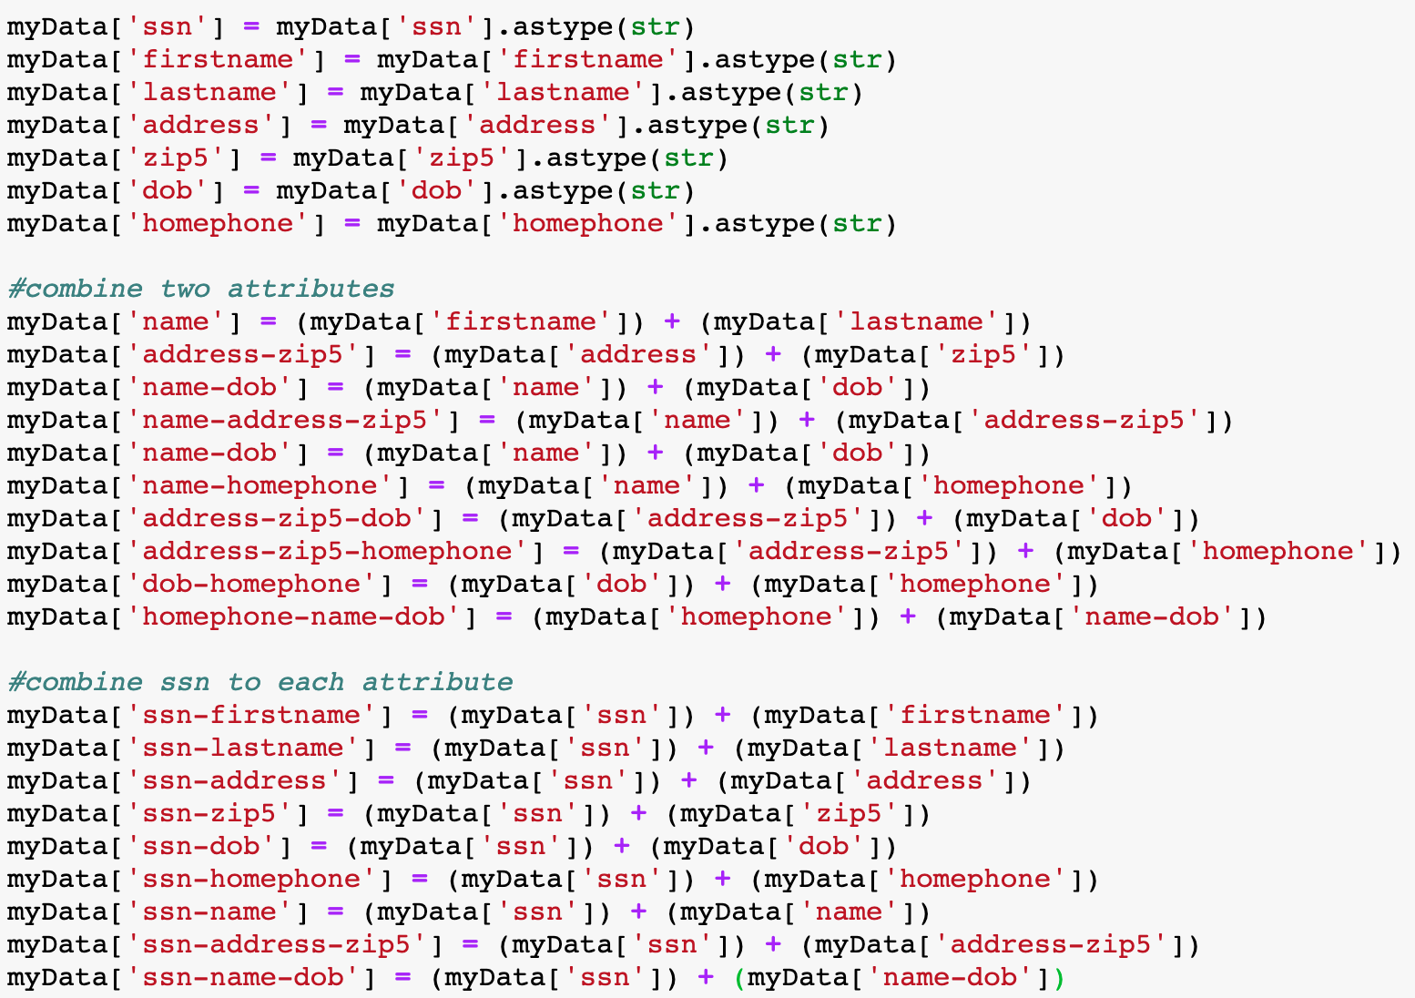
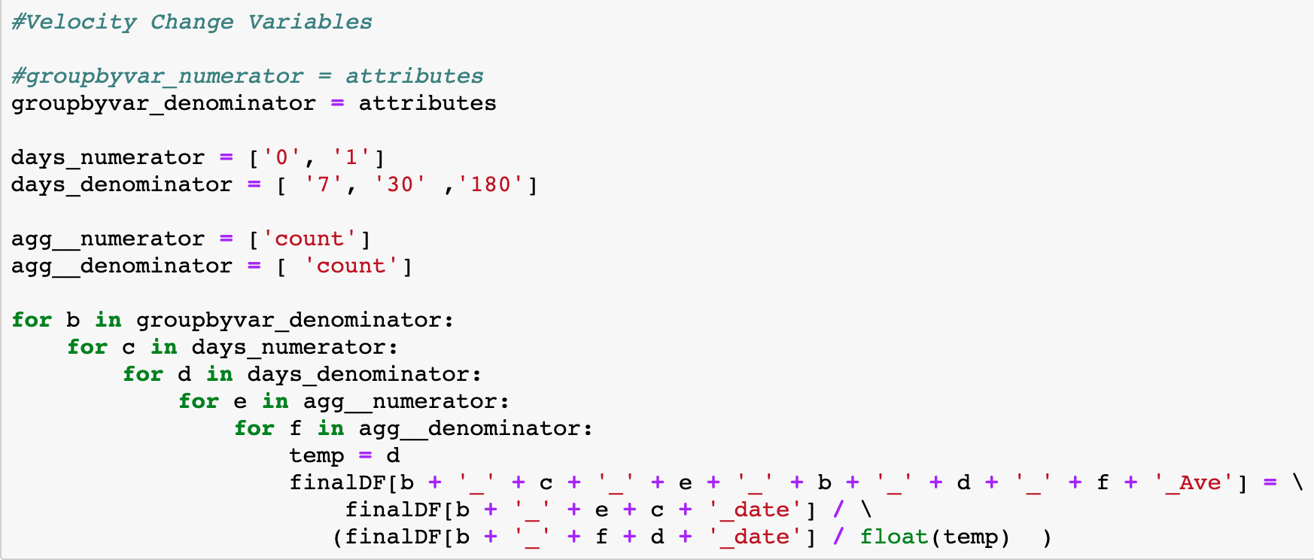
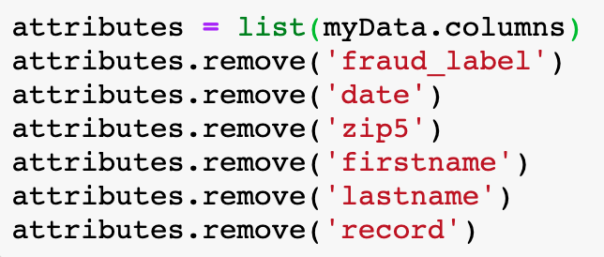
Some Python to Create Project 2 Variables
Start by reading the cleaned data file

